Slide 1
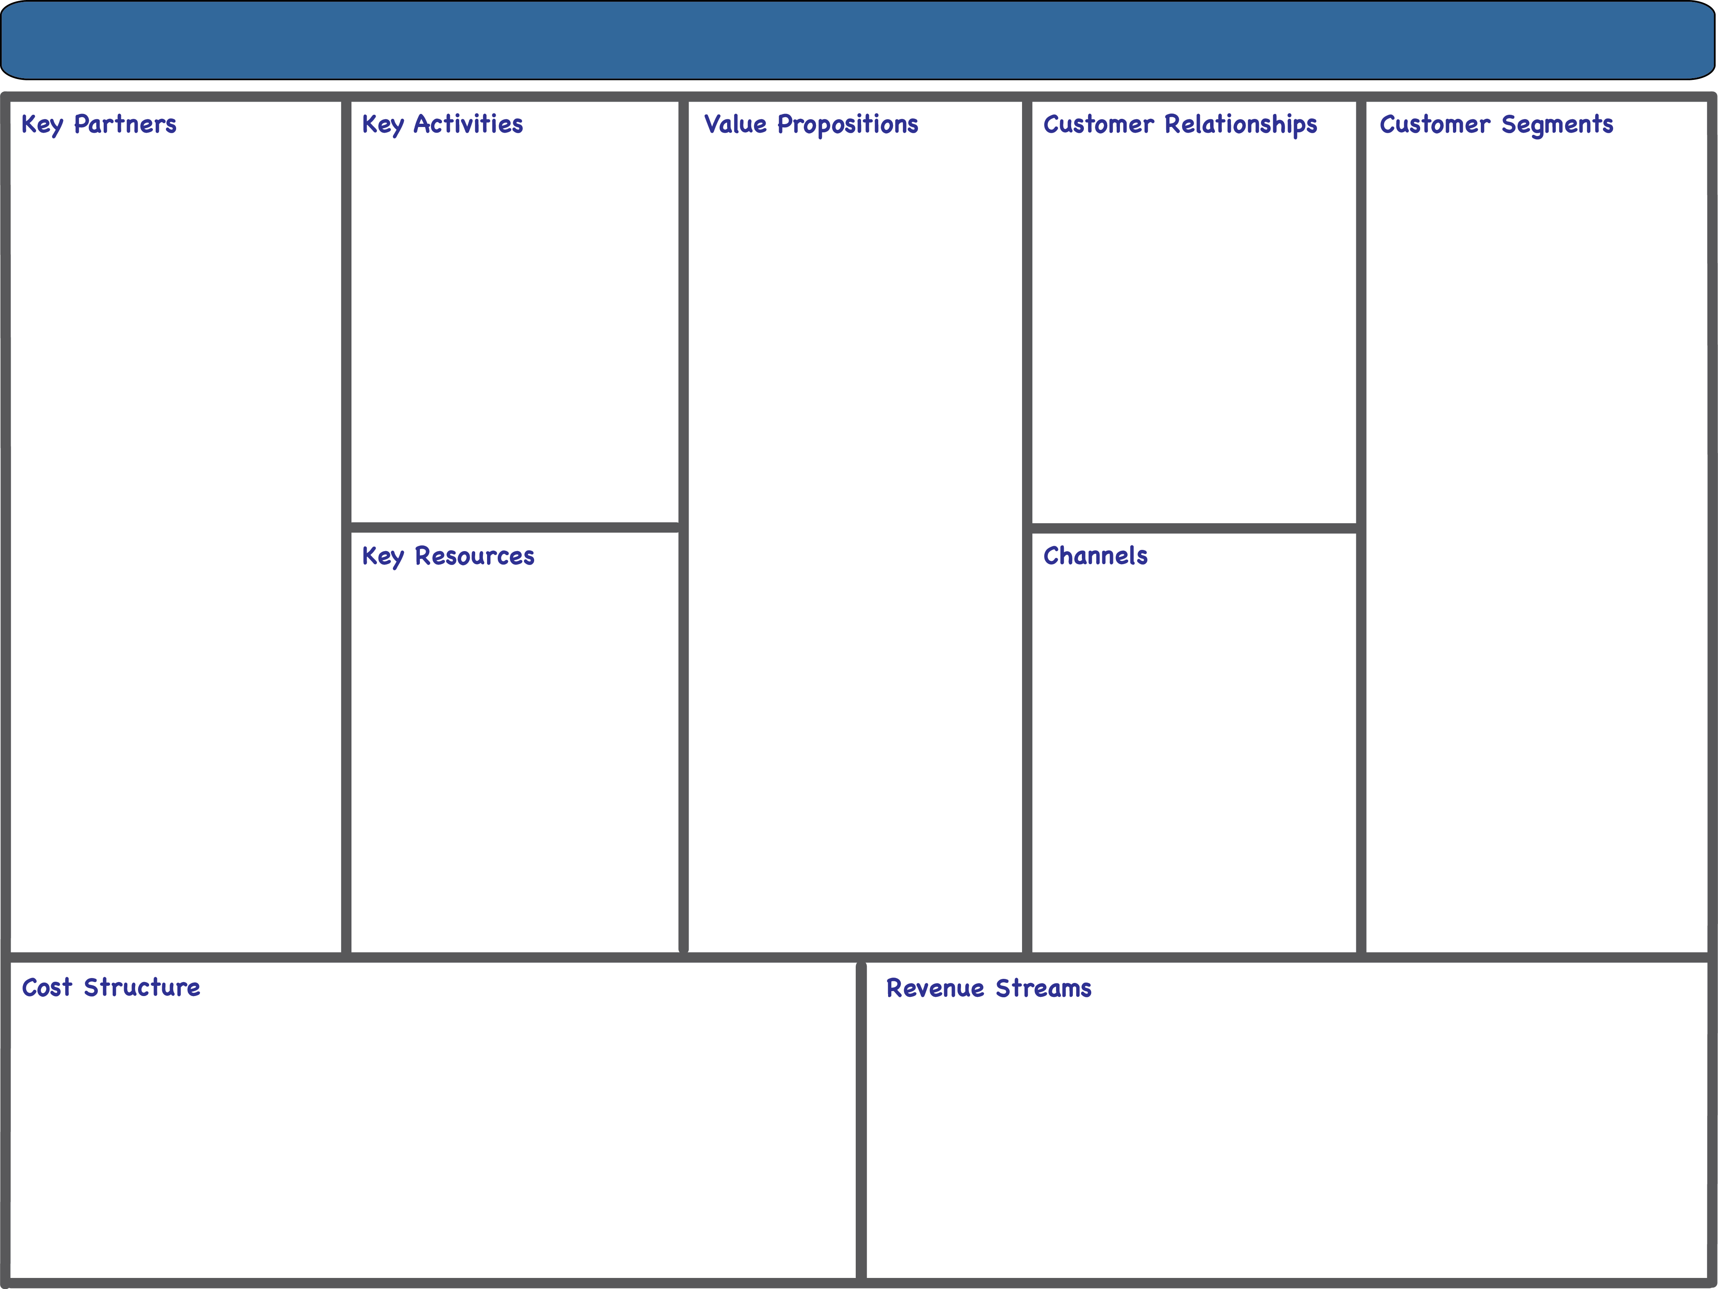







Waze Business Model Canvas
Key Activities
Real-Time Traffic Monitoring
App Development
Data Analysis
Marketing
Community Engagement
Value Propositions
Accurate Real-Time Navigation
Time and Cost Savings
Community-Sourced Traffic Updates
Safety Alerts
Integration with Smart Devices
Carpooling Platform
Customer Relationships
Free App Usage
Personalized Ads
Active Community Engagement
Trust in Reliability
Continuous Improvement
Key Partners
Google (Parent Company)
Mapping Data Providers
Government Agencies
Automotive Manufacturers
Gas Stations and Convenience Stores
Insurance Companies
Customer Segments
Commuters
Travelers
Businesses(Advertisers)
Public Sector
Carpoolers
Key Resources
Mapping and Traffic Data
Software Development
Advanced Algorithms
IT Infrastructure
Large User Base
Engaged Community
Channels
App Stores
Website and Online
Platforms
API Integration
Social Media
Partner Websites
In-Car Navigation Systems
Cost Structure
Data Acquisition
Software Development
Marketing and Advertising
Infrastructure Maintenance
Research and Development
Community Engagement
Revenue Streams
Location-Based Advertising
Premium Subscriptions
Carpool Commission Fees
Data Licensing
Partnerships and Sponsorships

